Slide 1

Text Mining & NLP - quick methodology overview
Antonio Miranda-Escalada
Text Mining Research Engineer
antonio.miranda@bsc.es

Slide 2







antoniomiresc@gmail.com
Antonio Miranda
Spain
BSc Biomedical Engineering - University Carlos III
MSc Big Data Analytics - University Carlos III
Bioinformatics Intern - CNIC
Biometrics research assistant - University Carlos III
Deloitte Analytics department
NLP Research - Barcelona Supercomputing Center
Abroad
Exchange program at University of California, Irvine
Short stay at Biomedical Research Foundation Academy Of Athens

Slide 3
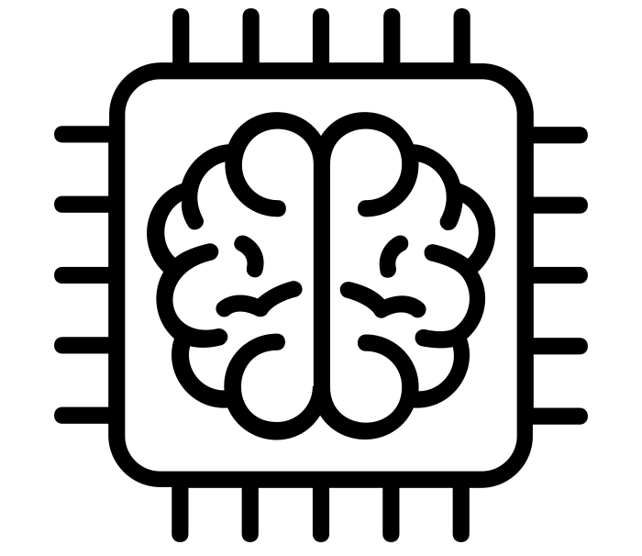
Machine Learning

Slide 4
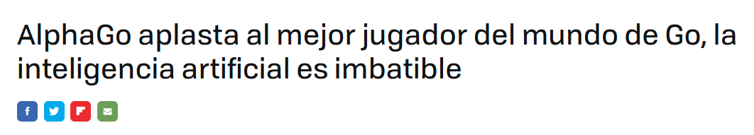
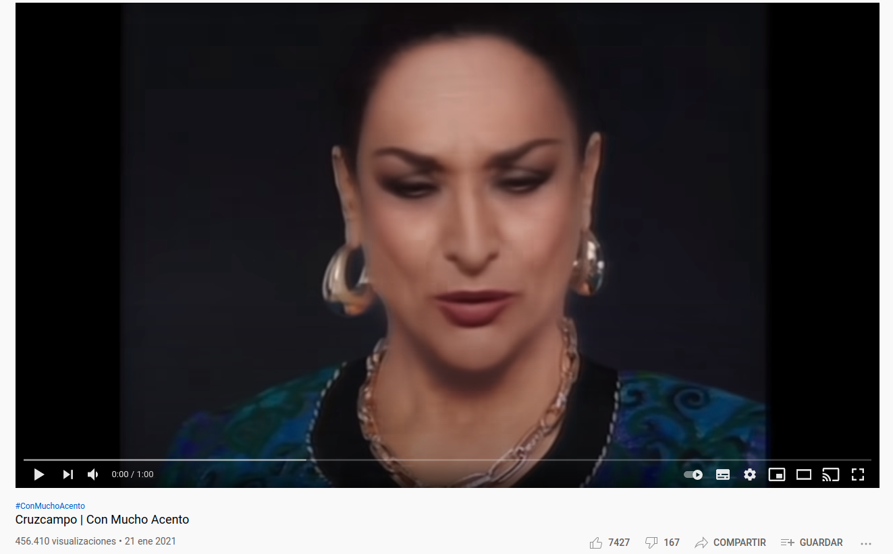
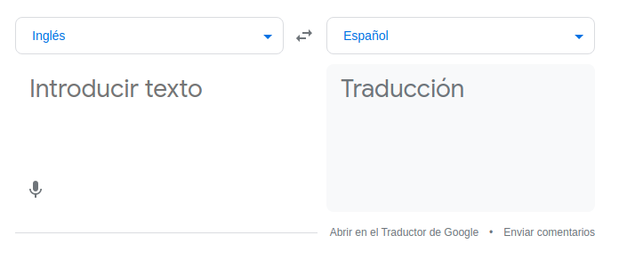
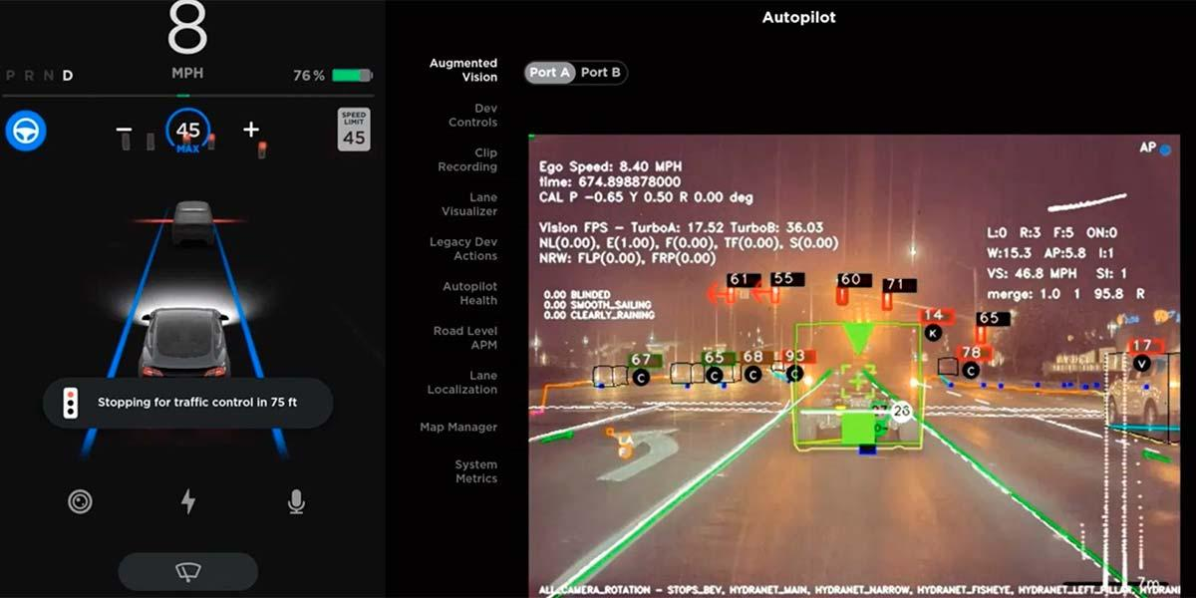
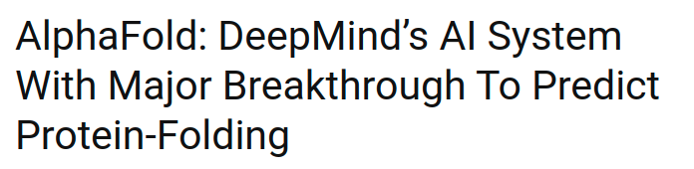
Machine Learning breakthroughs

Slide 5

Introduction to Machine Learning
Wikipedia definition: “computer algorithms that improve automatically through experience and by the use of data”
Machine creates its own rules or behaviors on how to respond to an information (this is called “training” the machine learning model).
Machine creates these responses based on previously provided information
Past information
ML algorithm
Trained model
+
=

Slide 6
Introduction to Machine Learning
Wikipedia definition: “computer algorithms that improve automatically through experience and by the use of data”
Machine creates its own rules or behaviors on how to respond to an information (this is called “training” the machine learning model).
Machine creates these responses based on previously provided information
Sentences in English and in Spanish
ML algorithm
+
=

Slide 7
Introduction to Machine Learning
Example: I have some points and I know that, usually, points belong to two groups (Black and Red). I want to design a system that classifies new points into Black and Red groups.
Y
X

Slide 8
Introduction to Machine Learning
Example: I want to classify new points into Black and Red groups.
Traditional approach - expert knowledge:
Since I have years of experience working with Black and Red groups, I know that points with X>3 usually belong to the Red group. Then, I write the following rule “If X>3, the new point belongs to the Red group” → handcrafted rules based on experience

Slide 9
Introduction to Machine Learning
Example: I want to classify new points into Black and Red groups.
Traditional approach:
Since I have years of experience working with Black and Red groups, I know that points with X>3 usually belong to the Red group. Then, I write the following rule “If X>3, the new point belongs to the Red group” → handcrafted rules based on experience
When I have a new point, just follow my handcrafted rule to place it in the Black or Red group
Example: new point (4, 0.5)
NEW POINT
Y
(4, 0.5)
X

Slide 10
Introduction to Machine Learning
Example: I want to classify new points into Black and Red groups.
Traditional approach:
Since I have years of experience working with Black and Red groups, I know that points with X>3 usually belong to the Red group. Then, I write the following rule “If X>3, the new point belongs to the Red group” → handcrafted rules based on experience
When I have a new point, just follow my handcrafted rule to place it in the Black or Red group
Example: new point (4, 0.5) → RED
NEW POINT
Y
(4, 0.5)
X

Slide 11
Introduction to Machine Learning
Example: I want to classify new points into Black and Red groups.
Machine learning approach - algorithm learns from past data:
Past information
ML algorithm
Trained model
+
=

Slide 12
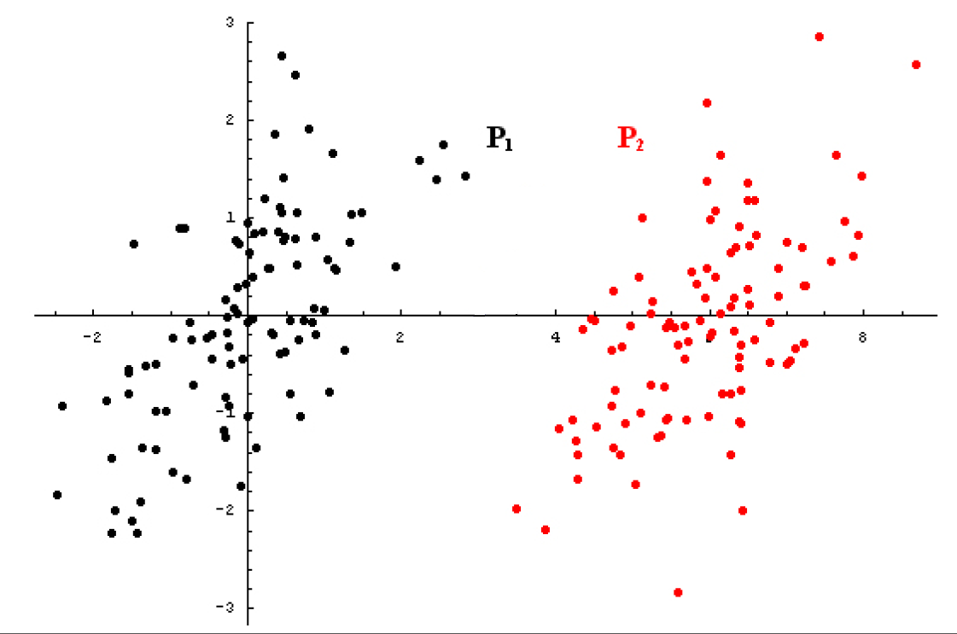
Introduction to Machine Learning
Example: I want to classify new points into Black and Red groups.
Machine learning approach - algorithm learns from past data:
Collect past examples of Black and Red points & feed them to the machine (this is called “training” the algorithm)
past examples

Slide 13
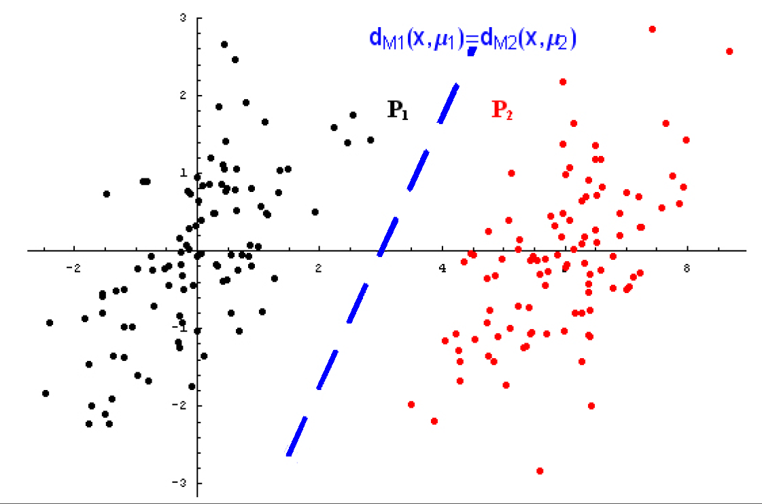
Introduction to Machine Learning
Example: I want to classify new points into Black and Red groups.
Machine learning approach:
Collect past examples of Black and Red points & feed them to the machine.
It creates its own rule → self-created rule based on previous data → that is the difference!
past examples
past examples

Slide 14
Introduction to Machine Learning
Example: I want to classify new points into Black and Red groups.
Machine learning approach:
Collect past examples of Black and Red points & feed them to the machine.
It creates its own rule
When I have a new point, just follow the rule created by the machine to place it in the Black or Red group
past examples
past examples

Slide 15
Introduction to Machine Learning
Example: I want to classify new points into Black and Red groups.
Machine learning approach:
Collect past examples of Black and Red points & feed them to the machine.
It creates its own rule
When I have a new point, just follow the rule created by the machine to place it in the Black or Red group
NEW POINT
(4, 0.5)
past examples
past examples

Slide 16

Machine Learning applications in biomedical (and non-biomedical) NLP

Slide 17
Recap from Intro
Problem: I do not know the color or a point. I want to predict the color or a point (Black or Red)
We gave to the algorithm: past Black and Red points
The algorithm created rules to: decide which coordinates of a new point determine its colour
NEW POINT
(4, 0.5)
past examples
past examples

Slide 18
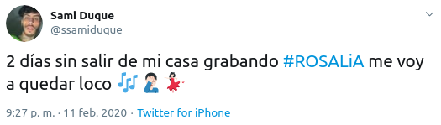
DeepMoji
Problem: I want to know which emoji I should add at the end of a tweet.
We gave to the algorithm: past tweets with the emojis that a real user has written
The algorithm created rules to: decide which emoji fits in the end of a new tweet
past examples
past examples
https://deepmoji.mit.edu/
Notes:
Similar to the Black and Red points example.
Before, we were giving the point coordinate and its color to the algorithm. Now we give the tweet and its emojis.

Slide 19
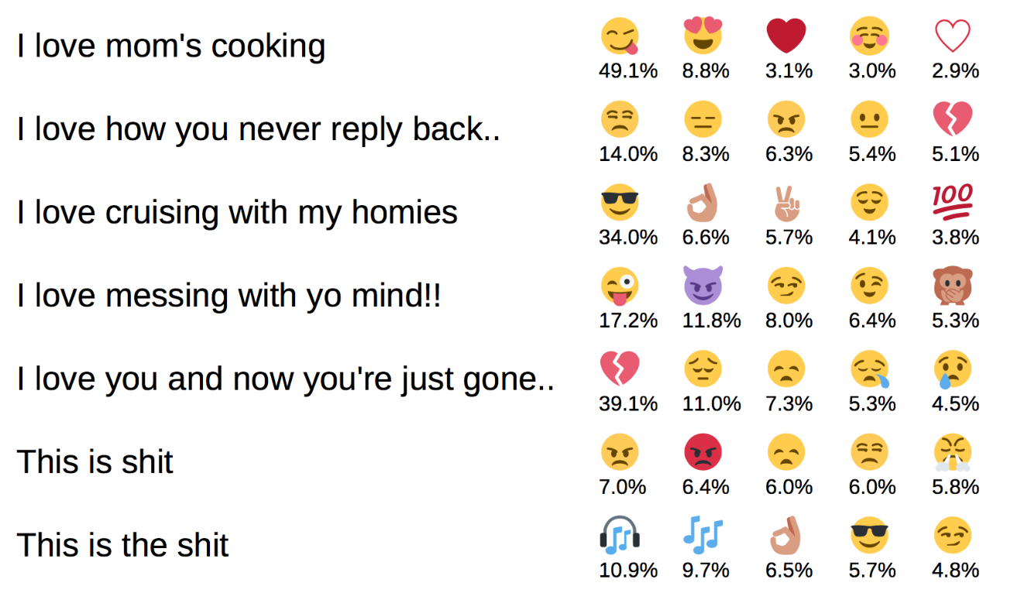
DeepMoji
New tweets
Predicted emoji

Slide 20
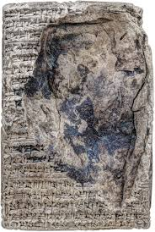
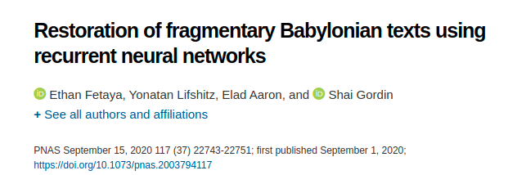
Restoration of fragmentary Babylonian texts
Problem: In old cuneiform clay tablets there are gaps (because they are old). When there is a gap in the middle of a sentence, I want to predict which word fits there.
We gave to the algorithm: past complete sentences
The algorithm created rules to: decide which word fits in the gap of a new sentence
https://www.pnas.org/content/117/37/22743
Notes:
Similar to the black and red points. As we were giving the point coordinates and its color to the algorithm, we are now giving the past sentence and the word that fits in the middle

Slide 21


Our job at BSC: Finding symptoms in COVID-19 reports
Problem: I have 50K medical reports from COVID-19 patients from a major hospital in Barcelona. I want to get the symptoms and previous diseases of a patient. As well as the medications he/she received.
Motivation: I want to learn which medications work better for patients with different symptoms and previous diseases. But I cannot read 50K medical reports. If I extract the symptoms, previous diseases and medications together with the outcome of the patient and put them in a table, I could extract correlations.
Notes:
Similar to the black and red points. Before we were giving the point coordinates and its color to the algorithm, we are now giving the past sentence and the word that is tagged as symptom (or disease, or medicament, etc)

Slide 22
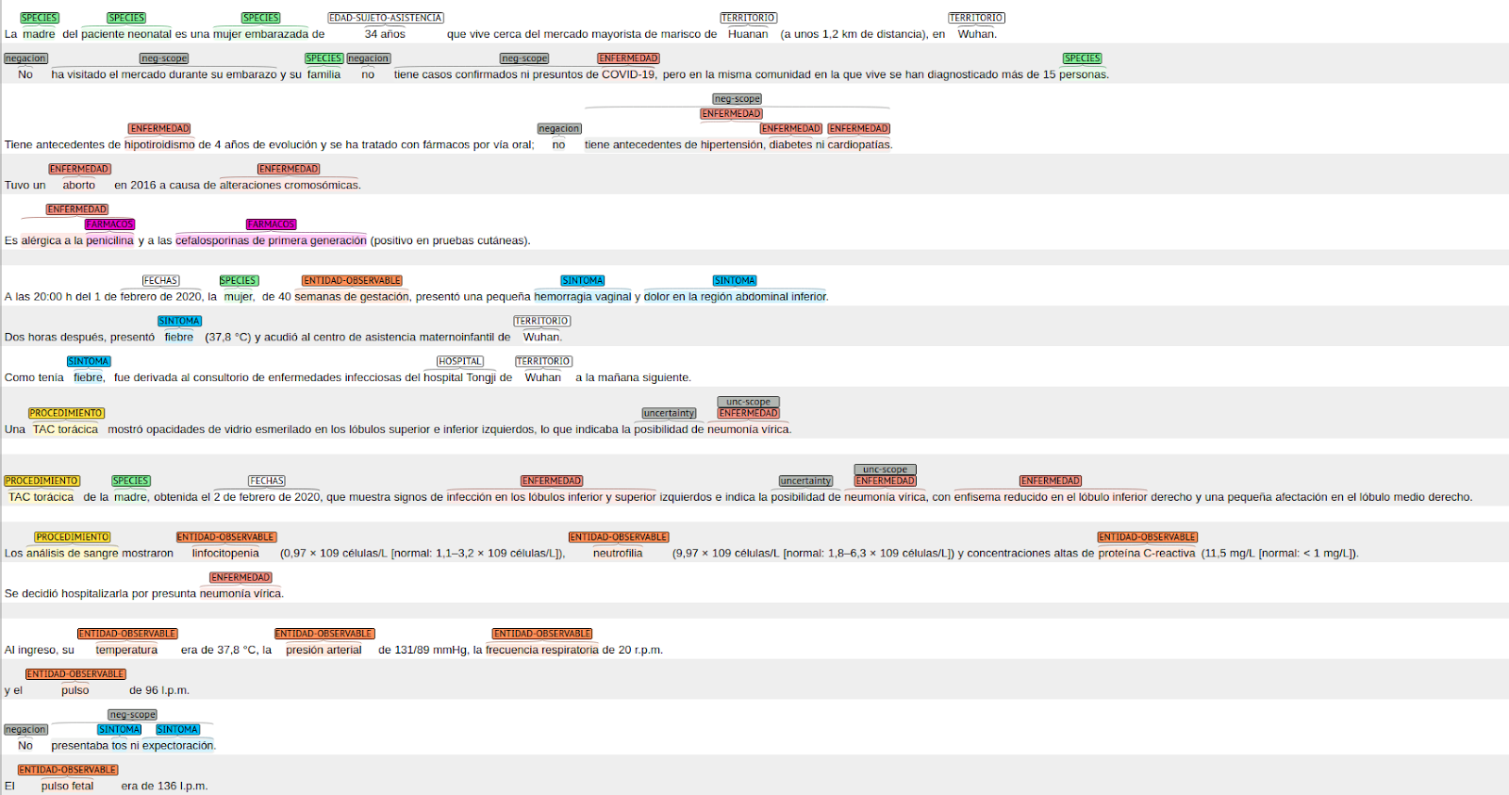
Our job at BSC: Finding symptoms in COVID-19 reports
We gave to the algorithm: past sentences with the symptoms, diseases and medications outlined
The algorithm created rules to: decide which word is a symptom, which one a disease, etc.

Slide 23
Basic NLP concepts

Slide 24
Basic NLP concepts
Gold Standard: A thing of superior quality which serves as a point of reference. It is used by the Machine Learning algorithm to create the rules. For example, in the points example, it would be the collection of past examples of Black and Red points.

Slide 25
Basic NLP concepts
Gold Standard: A thing of superior quality which serves as a point of reference. It is used by the Machine Learning algorithm to create the rules. For example, in the points example, it would be the collection of past examples of Black and Red points.
Corpus: Collection of text documents

Slide 26
Basic NLP concepts
Gold Standard: A thing of superior quality which serves as a point of reference. It is used by the Machine Learning algorithm to create the rules. For example, in the points example, it would be the collection of past examples of Black and Red points.
Corpus: Collection of text documents
Token: sequence of characters in some particular document that are grouped together as a useful semantic unit for processing
1 Sentence:
La paciente, que vive en Wuhan, tiene fiebre
10 Tokens:
La paciente , que vive en Wuhan , tiene fiebre

Slide 27
Basic NLP concepts
Named Entity Recognition (NER): detection and classification of relevant parts of text (entities)
Input
Plain text
Notes:
The goal of this step is to extract the relevant parts of the text.
We start with the full text (for example, the patient records) and we obtain from it the list of mentioned symptoms, procedures, etc (whatever we are interested in)

Slide 28
Basic NLP concepts
Named Entity Recognition (NER): detection and classification of relevant parts of text (entities)
Input
Plain text
Detected relevant parts of text categorized
Output
COVID-19 clinical case report with entities detected by NER system

Slide 29




Basic NLP concepts
Text Classification: categorizing text into organized groups (for example, into medical areas)
Oncology
Cardiology
Dermatology

Slide 30
Example: Text Classification with Named Entity Recognition

Slide 31
Expectations
This is a quick introduction:
I expect you to understand the example
I expect you to understand the motivation behind every step we do to solve the use case
I do not expect you to understand every line of code. In NLP we mostly use Python because it is the language that allows us to do all of the NLP steps.

Slide 32
Problem
I have 2500 documents about the condition and evolution of patients suffering from diverse problems: COVID-19, oncology problems, cardiology problems, urology and many other different medical areas.
Goal: I am an oncology doctor and I want to study just the ones about oncology.
Obviously, I do not want to read the 2500 documents before starting to study them...
Oncology
2500
Notes:
I have 2500 clinical case reports about the disease and evolution of patients suffering from COVID-19, oncology problems, cardiology problems, urology and many other different medical areas.
I am interested in studying just the ones about oncology.
I do not know how many of them are about oncology. I do not know what are the other medical areas that I need to discard. I do not know which types of cancer my clinical reports talk about… I only know that, within the 2500 clinical case reports, there are some about oncology.
Obviously, I do not want to read the 2500 documents before starting to study

Slide 33
Problem
I have 2500 documents about the condition and evolution of patients suffering from diverse problems: COVID-19, oncology problems, cardiology problems, urology and many other different medical areas.
Goal: I am an oncology doctor and I want to study just the ones about oncology.
Obviously, I do not want to read the 2500 documents before starting to study them...
I know:
There are some documents that talk about oncology.
All documents are from Spanish- speaking countries
I do not know:
I do not know how many of them are about oncology.
I do not know what are the other medical areas that I need to discard.
I do not know which types of cancer my clinical reports talk about

Slide 34
Approach 1: Text Classification
Approach 1: Text classification

Slide 35
Approach 1: Text Classification
Approach 1: Text classification
Similar to the Black and Red points.

Slide 36
Approach 1: Text Classification
Approach 1: Text classification
Similar to the Black and Red points.
If I had past examples of oncology, cardiology, covid, etc documents, I could input them to a classification algorithm and it would create its own classification rules. Then, I could classify my new 2500 documents.

Slide 37
Approach 1: Text Classification
Approach 1: Text classification
Similar to the Black and Red points.
If I had past examples of oncology, cardiology, covid, etc documents, I could input them to a classification algorithm and it would create its own classification rules. Then, I could classify my new 2500 documents.

Slide 38
Approach 1: Text Classification
Approach 1: Text classification
Similar to the Black and Red points.
If I had past examples of oncology, cardiology, covid, etc documents, I could input them to a classification algorithm and it would create its own classification rules. Then, I could classify my new 2500 documents.
But this time, I do not know what are the other medical specialties. And I do not have these past examples.
Notes:
This is a the most common problem in Machine Learning! I do not have past data to learn from. Or I have very few data to learn from

Slide 39
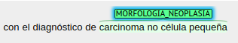
Approach 2: Named Entity Recognition
Approach 2: Named Entity Recognition
I will locate the clinical case reports that mention entities related to oncology (such as “metástasis” or “carcinoma lobulillar infiltrante”).
I will assume that if a document mentions an oncology entity, I will be interested in this document.

Slide 40
Approach 2: Named Entity Recognition
Traditional Named Entity Recognition:
Get a list of all oncology-related terms
Search for those terms in my documents

Slide 41
Approach 2: Named Entity Recognition
Traditional Named Entity Recognition:
Get a list of all oncology-related terms
Search for those terms in my documents
Problems:
Do I have such 100% complete list? Probably not…
Real-world vocabulary is different from textbook vocabulary. Medical doctors (and nobody) do not write as in textbooks.
Documents are written in Spanish-speaking countries.
Other languages: what happens if some documents are written in Catalan or Galician?
Dialects: what happens if there are Spanish variants between Spain and México?
How do I account for typographical errors?
Instead of “carcinoma lobulillar infiltrante”, I could have “carcinoma lobulliliar infiltrante”
Notes:
Those problems are solved (at least partially and if you do it well) with Machine Learning approaches to Named Entity Recognition.

Slide 42
Approach 2: Named Entity Recognition
Today’s Named Entity Recognition:
Use Machine Learning (Deep Learning) to find the oncology mentions
Past information
ML algorithm
+
1. Data preparation
2. Transform words into vectors
3. Train ML algorithm to detect oncology mentions
4. Detect oncology mentions with the trained model
Notes:
Machine Learning, and particularly Deep Learning, systems can learn patterns from the text that a human does not guess. Top-performing models take into account the words, the context in which they are appearing in the new sentence, the context in which they usually appear in literature, information about its meaning, etc.

Slide 43
Recap
Goal: Find documents about oncology in a collection of unknown documents
Approach:
Find oncology-related entities in the documents → use Machine Learning to find oncology-related documents
Every document with 1 oncology-related entity is a relevant document for me.
Oncology

Slide 44
Step 1: Data preparation
Motivation: real-world text is usually dirty, with bad encodings, text is in PDF and is difficult to parse, etc. To use it in any algorithm, we need to prepare it
Common steps:
encoding fixer
cleaning: punctuation and accents, special characters, numeric digits, leading, ending and vertical whitespace, HTML formatting, lowercasing
tokenization: split sentences into individual tokens

Slide 45
Step 2: Transform words into vectors
Motivation: Machine learning algorithms cannot work with raw text directly; the text must be converted into numbers: words must be transformed into vectors
Different ways:
One-Hot encoding
Bag-of-Words (BoW)
Word embeddings
Context embeddings
Language models

Slide 46
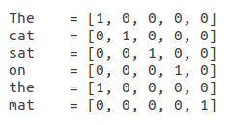
Step 2: Transform words into vectors - One-Hot encoding
Description: each word is represented as a binary vector that is all zero values except the index of the word, which is marked with a 1
Example: “The cat sat on the mat”
Not very useful: all word vectors are equally separated, if we have 300K words, our vectors have 300K dimensions, etc.
the
mat

Slide 47
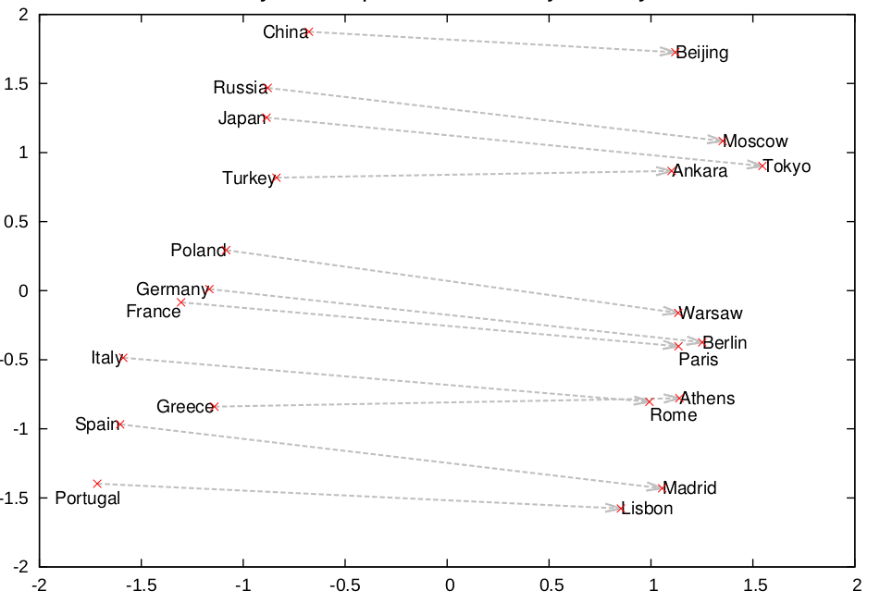
Step 2: Transform words into vectors - Word embeddings
Description: each word is represented as a real vector. Words with similar meanings are close in the vector space.
How to create them: the vectors are built with neural networks that use large collections of documents (example: the whole PubMed)
Limitations: do not take into account the context (e.g. “banco” has different meanings in different contexts)
 | X1 | X2 | ... | Xn
apple | 0.2 | 0.0 | ... | -0.3
doctor | 0.5 | -0.9 | ... | 0.11
injury | -1.5 | 0.4 | ... | -0.3
dog | -0.11 | 0.6 | ... | -0.3

Slide 48
Step 3: Train Machine Learning algorithm to detect oncology mentions
Motivation: Obtain a machine learning model ready to detect oncology mentions.
Steps:
Find a Gold Standard of Spanish documents with oncology mentions
Train the algorithm with the Gold Standard → it creates its own rules to detect the oncology mentions in the new 2500 documents.
Past information
ML algorithm
Trained model
+
=

Slide 49

Step 4: Use the trained machine learning algorithm to find oncology mentions
Motivation: I know have a model that finds oncology mentions. I will use it in my 2500 documents, find the oncology mentions and select the documents that have one or more of them.
Trained model
2500 docs
2500 docs with oncology mentions
E.g.

Slide 50

all icons are from https://www.flaticon.com/

Slide 51
Recap of the steps performed
Past information
ML algorithm
+
1. Data preparation
2. Transform words into vectors
3. Get trained model
4. Use trained model in my documents
Docu- ments

Slide 52
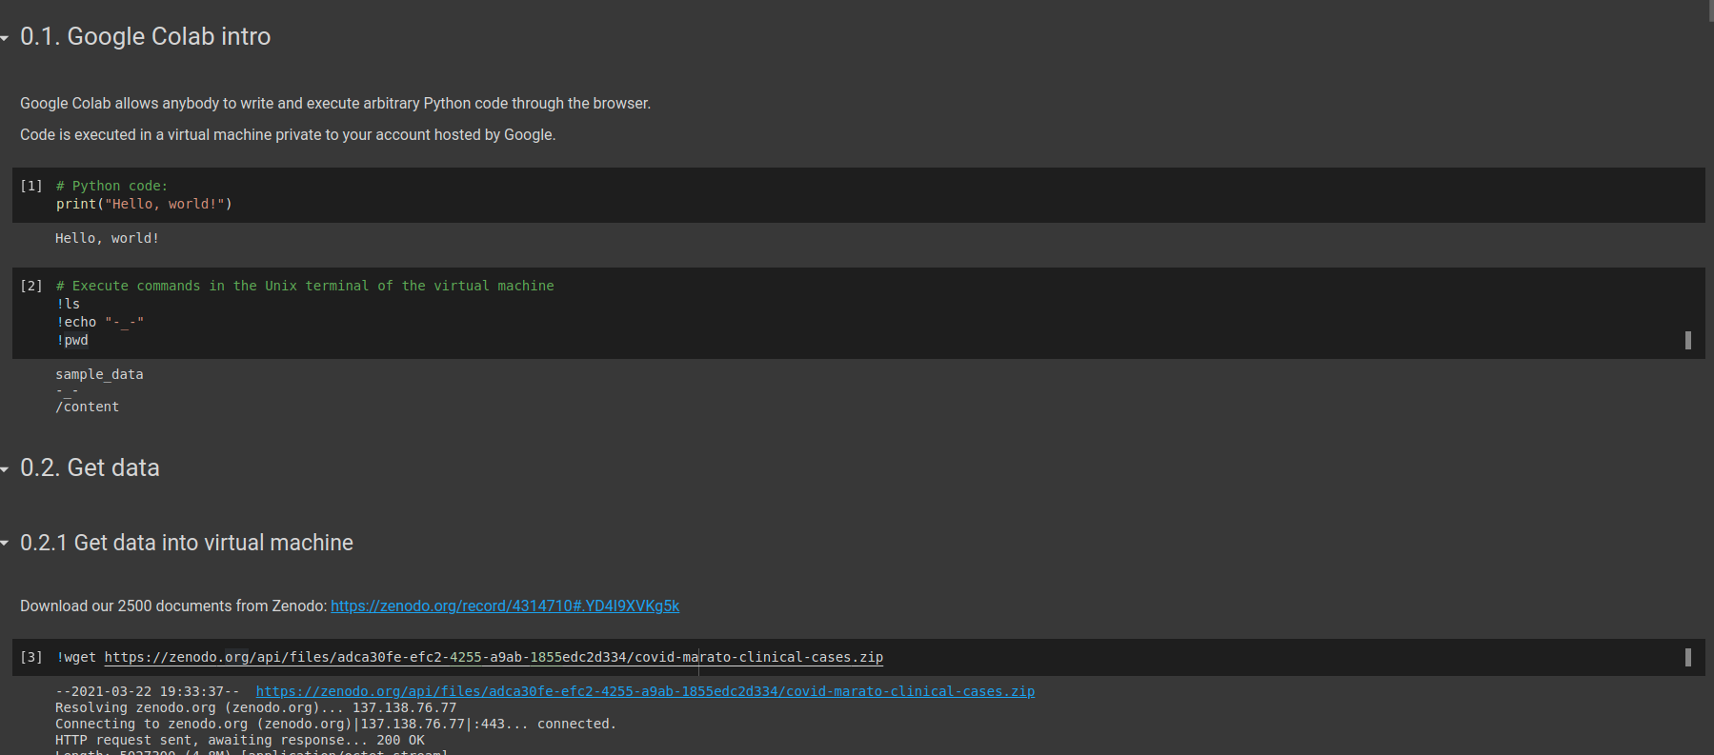
Do it with code!
Now, you will do all the steps with code!
Copy to open Google Colab (you must be logged in with a Google account):
https://tinyurl.com/h2hfrdv8

Slide 53
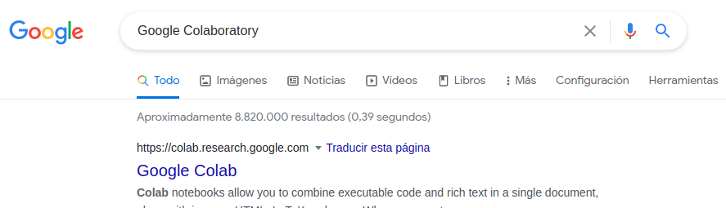

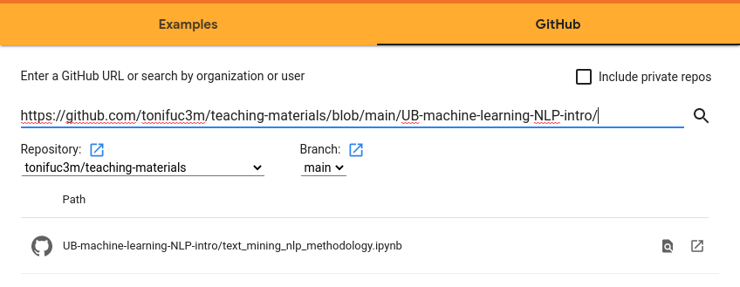
Do it with code!
If the URL does not work:
Open Google Colaboratory from Google
File > Open Notebook
On the GitHub window, search for https://github.com/tonifuc3m/teaching-materials/blob/main/UB-machine-learning-NLP-intro/
Select UB-machine-learning-NLP-intro/text_mining_nlp_methodology.ipynb

